Slide 1

BA Deep learning for NLP
Week 1 – February 5, 2021
Prof. dr. Stephan Raaijmakers

Slide 2
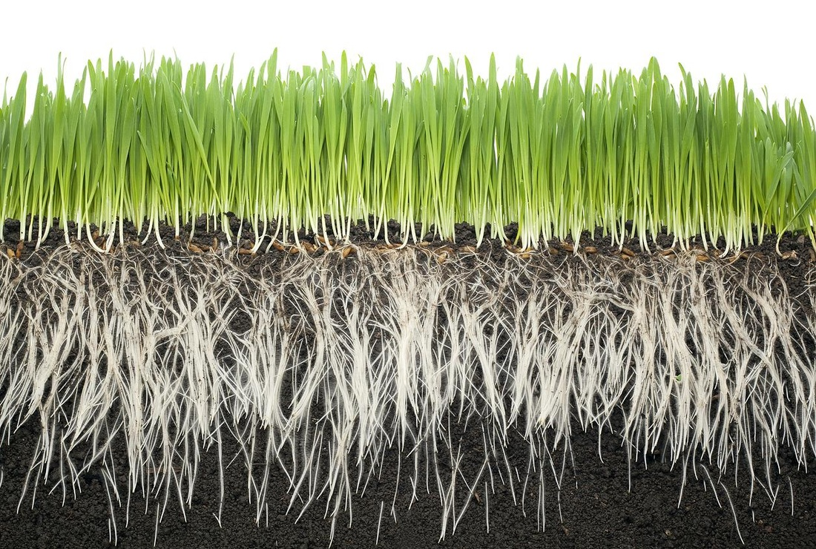
Overview of the course
In this course, you will learn:
How to practically implement deep learning-based natural language processing.
How to map well-known linguistic problems onto deep learning architectures.
A lot about machine learning, tuning and evaluating models.
How to program in Python (high-level).
We will adopt a grassroots approach: just start!
We will try to compensate as much as we can for background differences
This means that the skill set acquired will differ a bit from person to person.
The general aim: to get us all on the same page: understand how things work, and be able to piece together some of it.

Slide 3
Outline
Every week, we will go through some background (first hour), and discuss questions from last week.
Submit your questions before Tuesday end of day every week through Brighspace, in a dedicated form.
The second slot (2 hours) you will work on an exercise.
First hour: work together with one (or more, if uneven) student(s) on exercise.
Pairing will be changed every week, and will be put on Brightspace.
You will use Zoom breakout rooms.
Second hour: report issues. Short discussion. Continue. Contact me for problems.
Round up:
Exercise next week.
Including a short quiz.
Mid-term: we will have a contest (Kaggle), a machine learning competition!
Exam:
Joint assignment: code+text
Examination.

Slide 4


Who is your teacher?
Stephan Raaijmakers
ATW (Algemene Taalwetenschap) supplemented with Information Science and formal logic at Leiden
Computational linguist avant la lettre.
After graduation
Worked at Tilburg University on Dynamic Semantics and formal logic.
Worked at the Dutch Language Institute (INT, Leiden) as computational linguist (statistical NLP, machine learning).
From 2000-2012: at TNO as NLP/machine learning researcher. PhD with Antal van den Bosch and Walter Daelemans (Tilburg/Antwerp).
From 2012-2016 ran own company (Sentence, Amsterdam) on big data, NLP and deep learning.
From 2016-… back at TNO as Senior Scientist AI (explainable, communicative AI)
From 2020 on: professor of Communicative AI at LUCL.

Slide 5







Means to an end: technical tools
Google COLAB
Kaggle
Github repo: https://github.com/stephanraaijmakers/ba-dl4nlp
Mentimeter
Zoom
Python, Keras

Slide 6
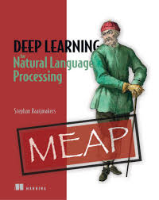
Literature
Stephan Raaijmakers: Deep learning for NLP (Manning, MEAP (epub), published on paper in April 2021 (est.))
Papers (see Github repo, folder ‘literature’, organized by week).

Slide 7
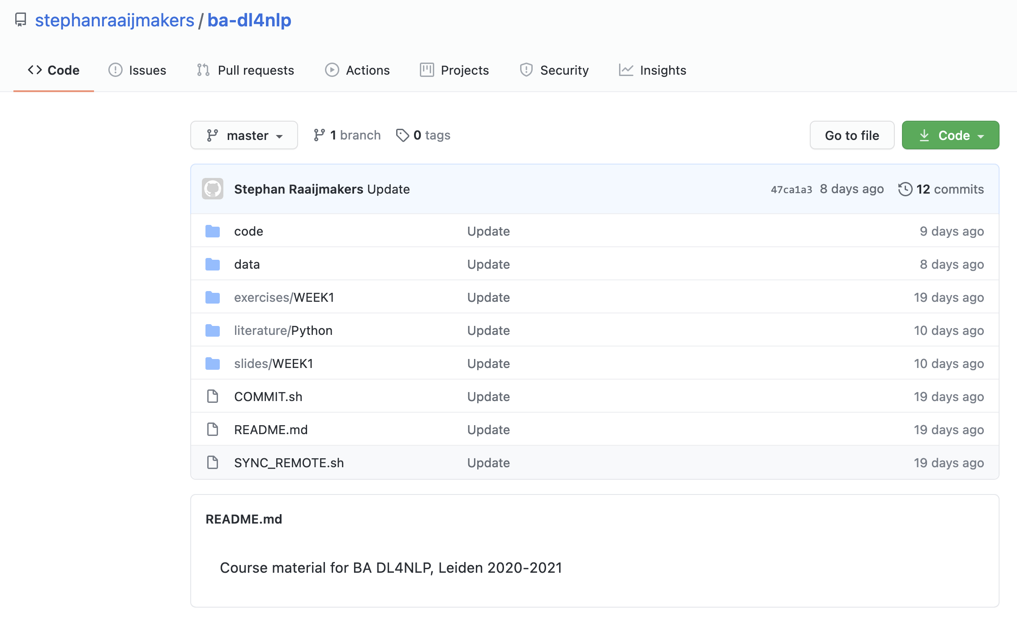
Github
A code repository facility
Making code available to others
URL: https://github.com/stephanraaijmakers/ba-dl4nlp

Slide 8
Our first Mentimeter

Slide 9
Week 1 – Background and setup
Introduction: NLP, machine learning and deep learning.
Background: Chapter 1 DL4NLP book
Paper week 1 on github
Practical session hour 1: working with text and training our very first neural network (already!)
Create a Google Colab account
Create a notebook “Perceptron”
Download data set from github.
Start working on exercise.
Practical session hour 2:
Report issues, and proceed.

Slide 10
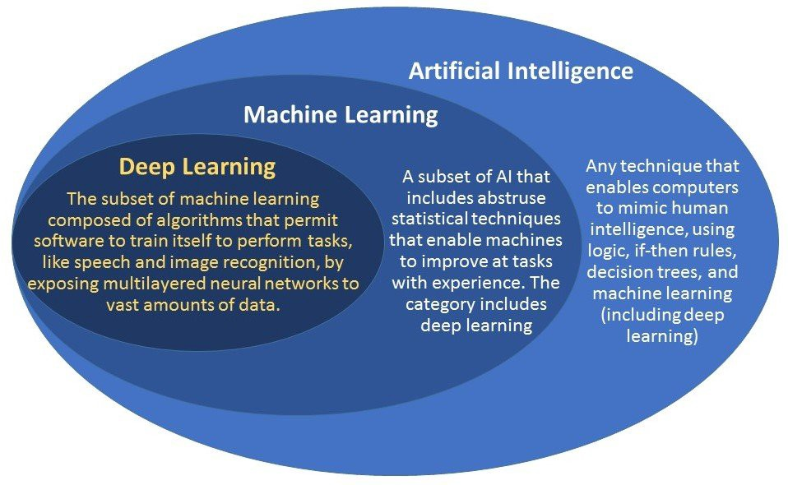
Introduction: AI, machine learning, NLP and deep learning

Slide 11
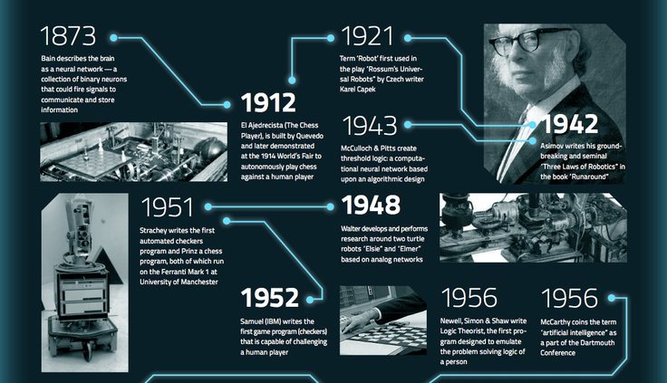
A rough timeline of AI (1/3)
https://steemit.com/education/@tayyabafridi/the-timeline-of-artificial-intelligence-ai

Slide 12
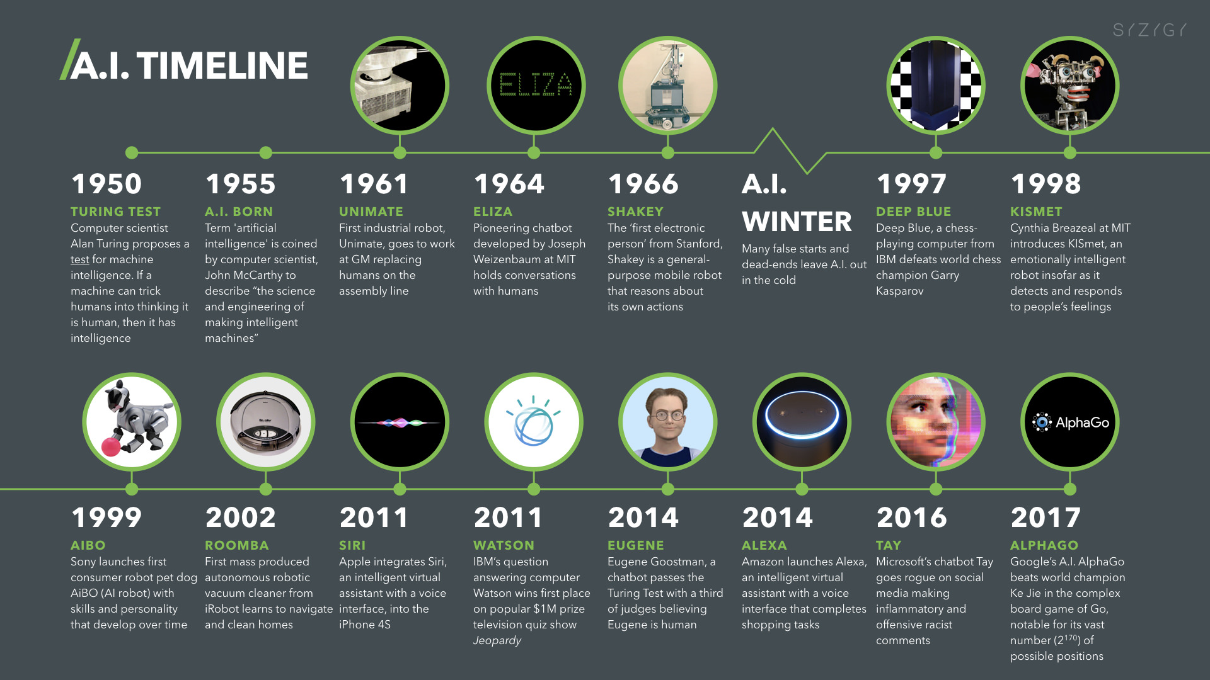
A rough timeline of AI (2/3)
https://digitalwellbeing.org/wp-content/uploads/2017/08/Artificial-Intelligence-AI-Timeline-Infographic.jpeg

Slide 13
A rough timeline of AI (3/3)

Slide 14
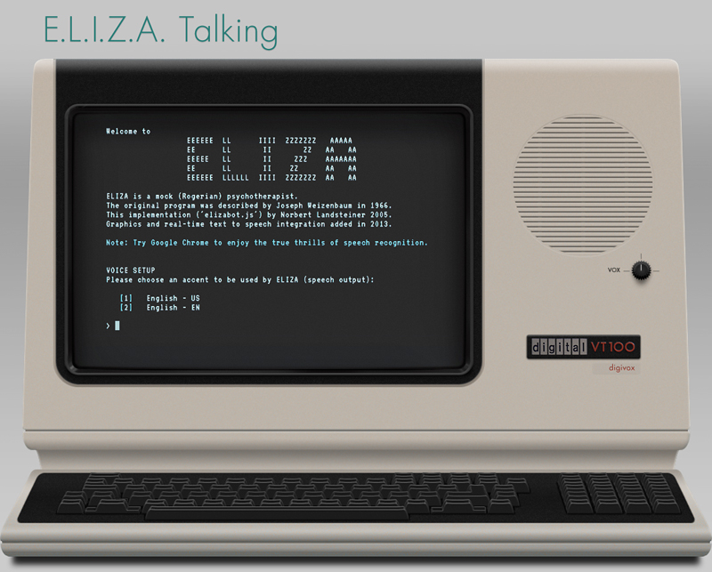
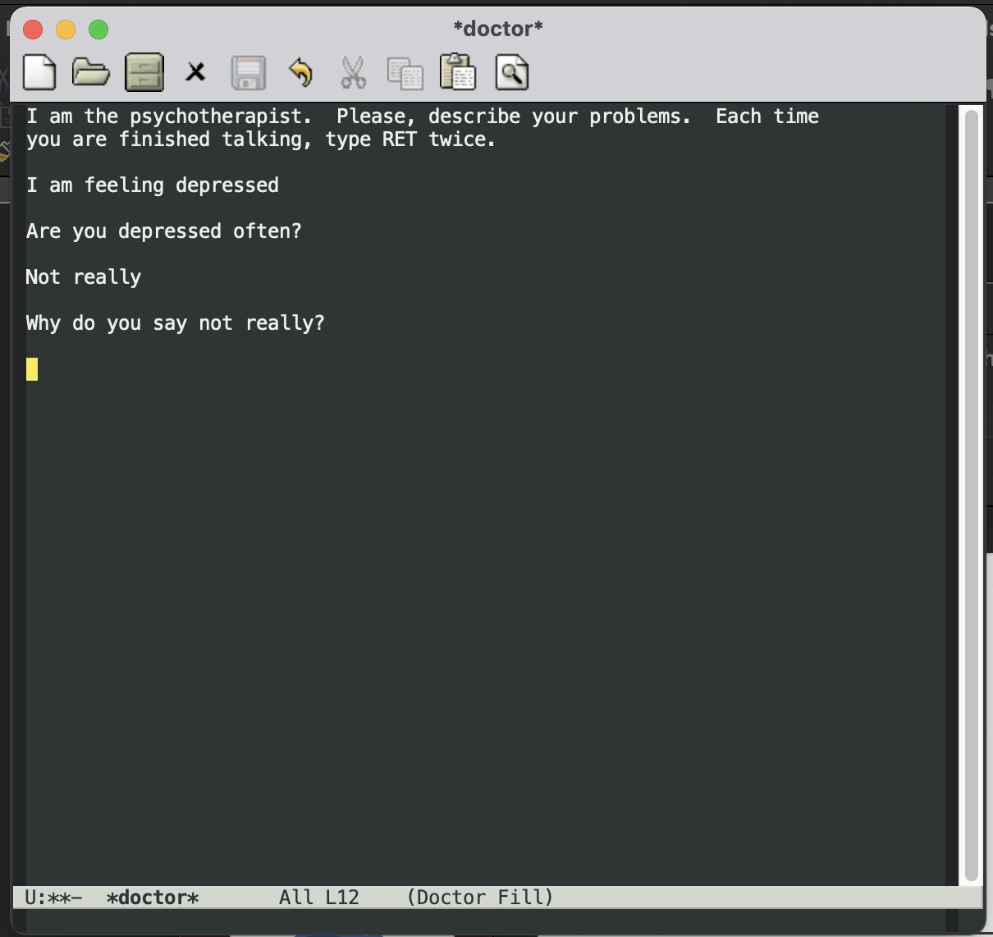
Eliza (1964)

Slide 15
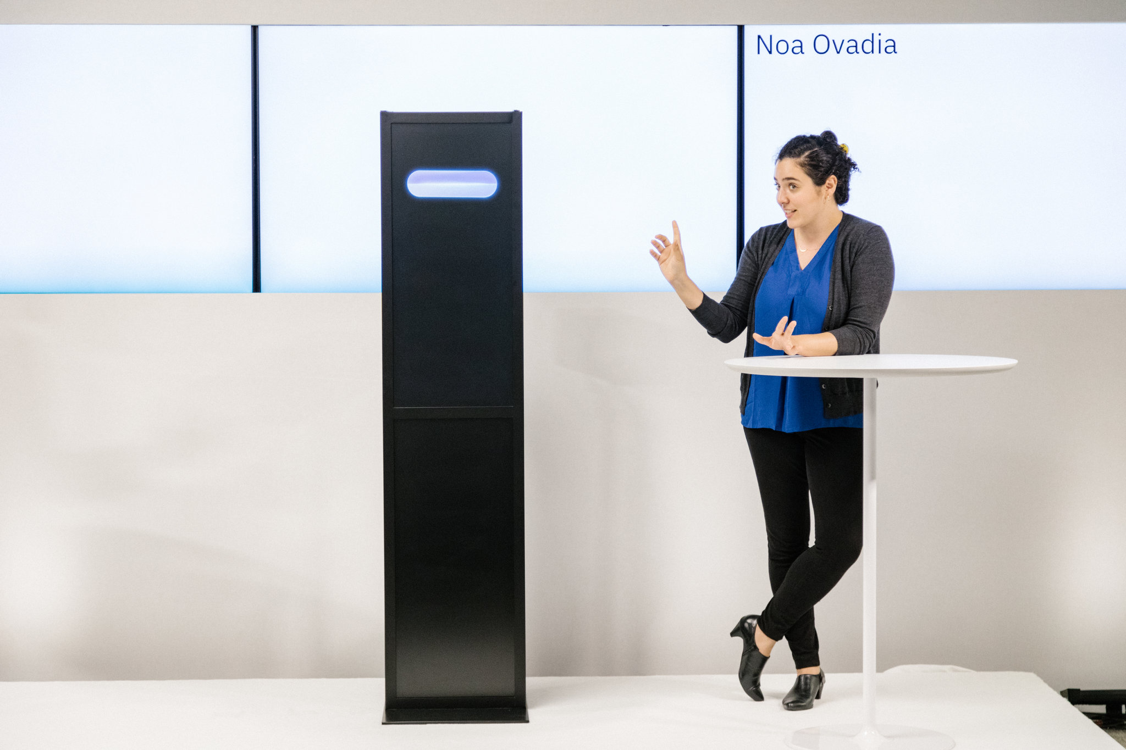
IBM Debater (2018)

Slide 16
AI

Slide 17
What is machine learning?
Machine learning involves teaching computers to learn from data.
Machine Learning infers a model from this data that can be used for making predictions on unseen data.
A Machine Learning algorithm builds such a model.
Usually, humans prepare data (labels, features), and teach a Machine Learning model to associate the labels with the features.
Predicting topics and sentiments for text
Predicting objects in images
Predicting gender and age in speech

Slide 18
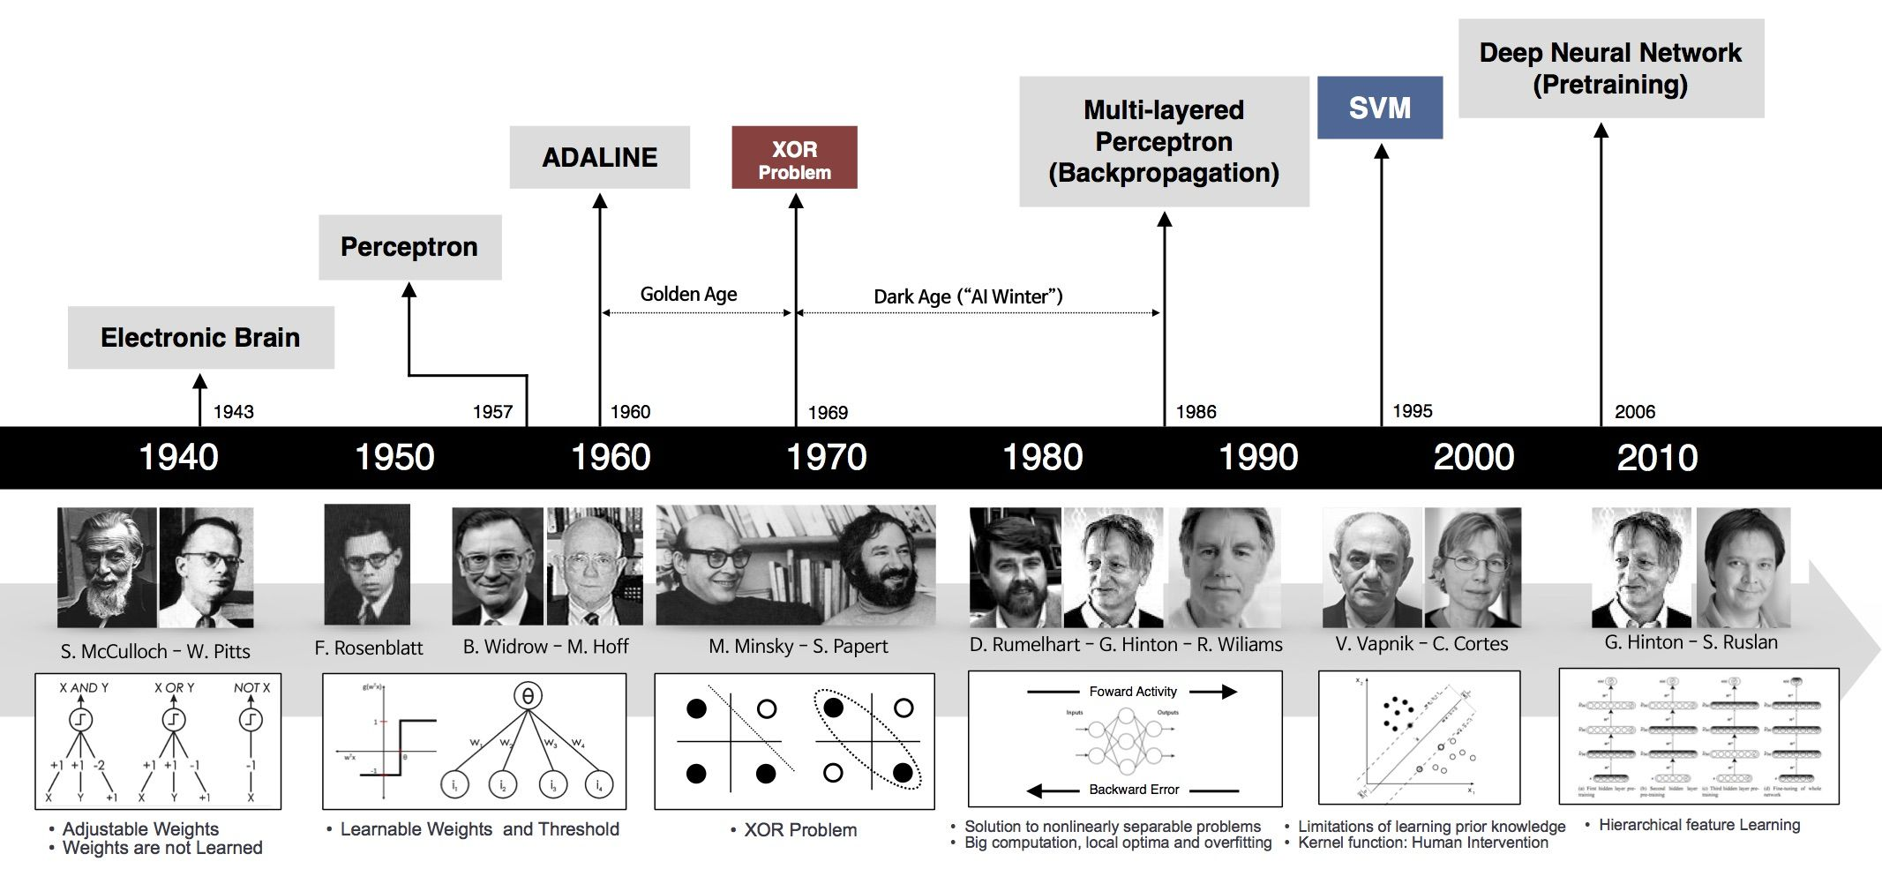
A timeline of machine learning

Slide 19
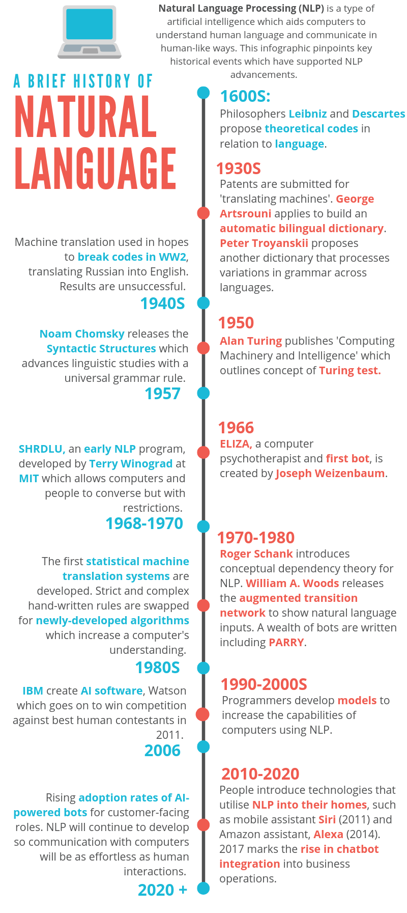
A timeline of NLP
Grammar-based, logic-based, rule-based: 1960-1985
Statistical NLP: 1985-2000
Machine-learning based NLP: 1990-now
Deep-learning based NLP: 2005-now
https://www.hostcomm.co.uk/blog/2019/evolution-natural-language-infographic

Slide 20
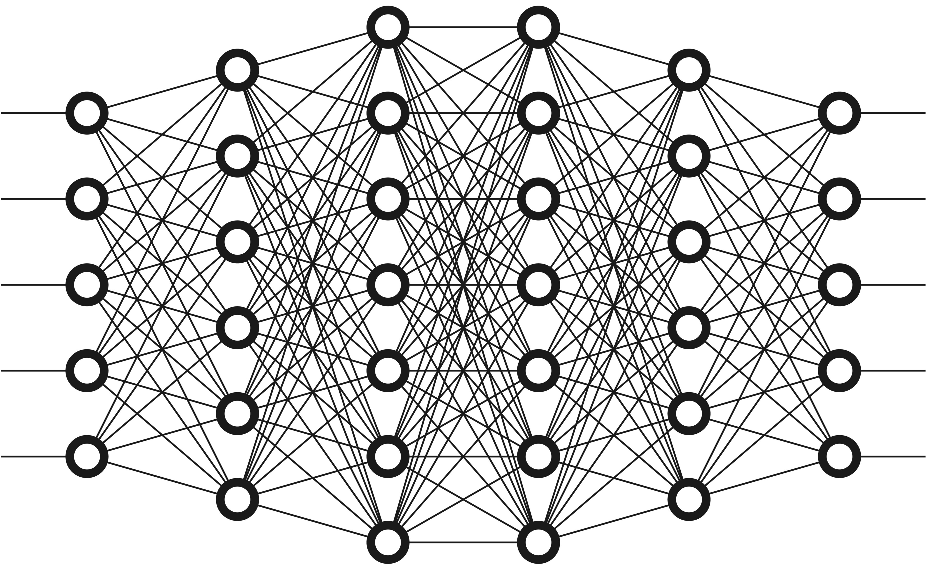
So, what is deep learning?
Based on neural networks
A neural network is a complex function mapping inputs to outputs.
Organized in connected layers
Layers exchange weighted information
The weights are learned from data and supervision.
The inputs are numerical representations of data (pixels, words, etc.)
Outputs: labels, predictions.
Deep: many layers, lots of abstraction.
Weighted connections
Input
Intermediate (hidden) layers
Output

Slide 21
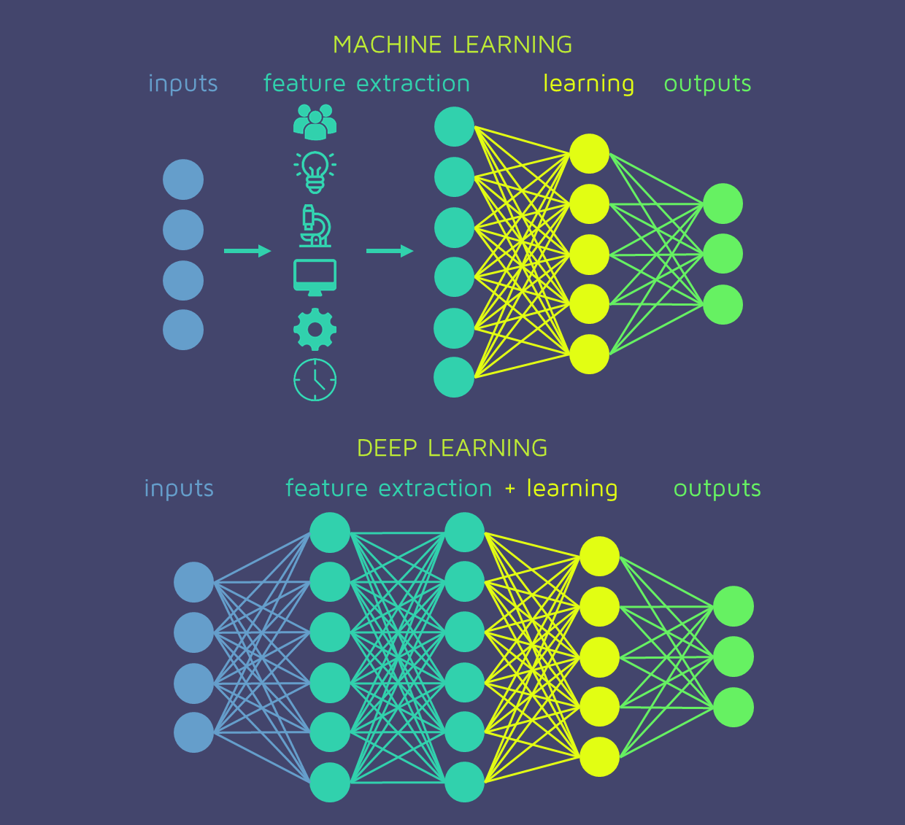
Deep learning is all about learning (vector) representations of data from data
https://quantdare.com/

Slide 22
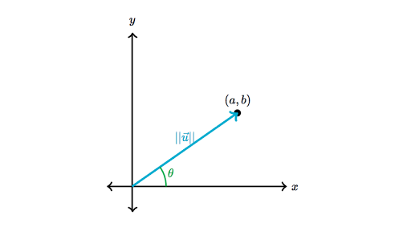
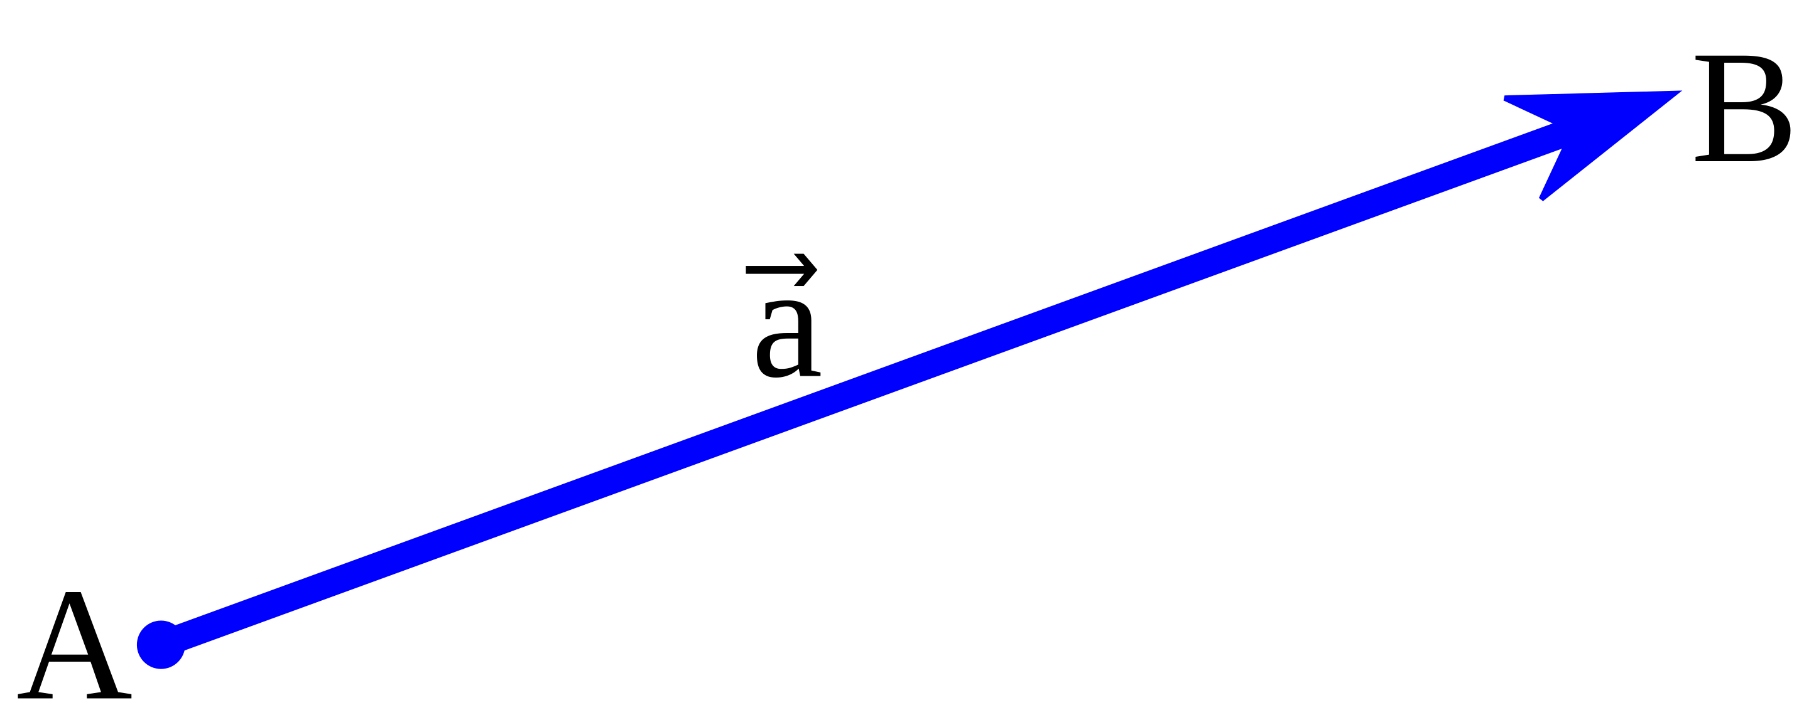
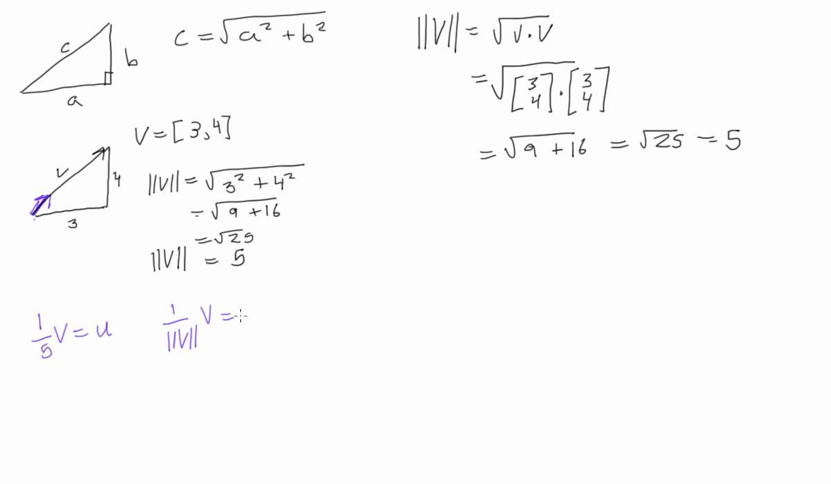
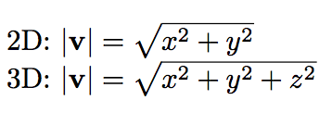
Vectors
A vector is an arrow connecting 2 or more numbers. These numbers can represent arbitrary data
Measurements by sensors
Word frequencies or other statistics
A vector can be interpreted as a point in a multi-dimensional space
[x,y] => (x,y): 2-D
[x,y,z] => (x,y,z): 3-D
[x₁,…,x_{n}] => (x₁,…,x_{n}) => n-D
Vectors have both magnitude (length) and direction as basic properties.

Slide 23
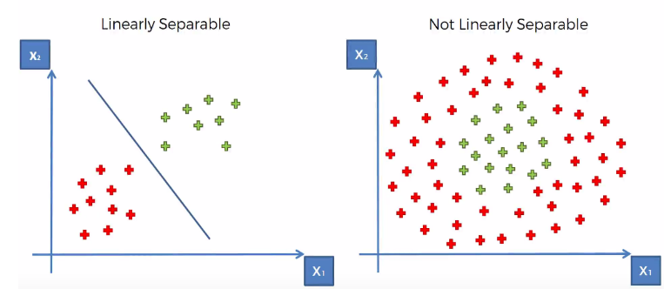
Similarity in vector space
Most machine learning estimates similarity in vector spaces
Some vector spaces have semantic structure (later)
Some ML algorithms manipulate vector spaces
Implicitly (Support Vector Machines use a clever kernel trick)
Explicitly: neural networks transform vector spaces step by step
Shared aim: linear separability of classes or labels
Draw a straight line between two classes, based on a linear function y=a+bx

Slide 24
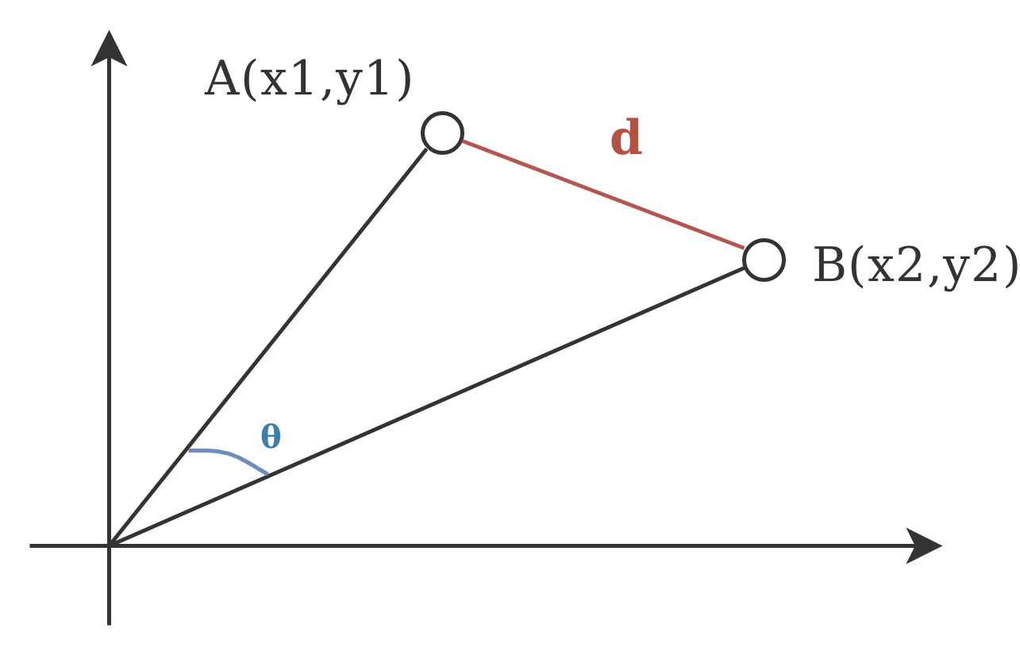
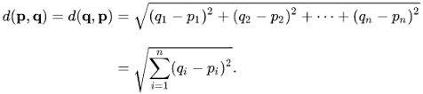
Cosine distance versus Euclidean distance

Slide 25
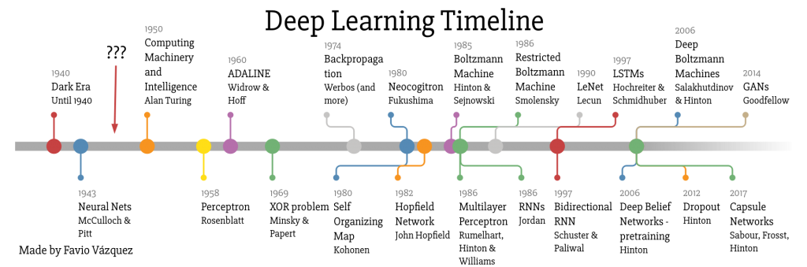
The deep learning (r)evolution
https://fabian.friedrichs.ws/research/deep-learning/ and https://trends.google.com/trends/explore?date=all&q=deep%20learning

Slide 26
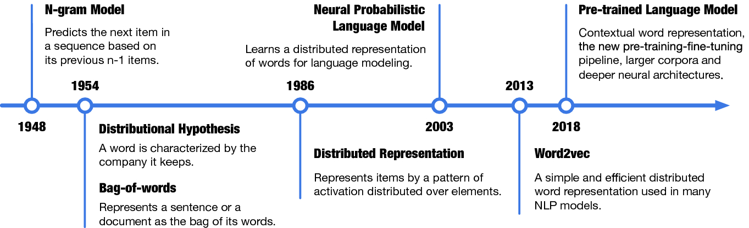
A timeline of representation learning (1/2)

Slide 27
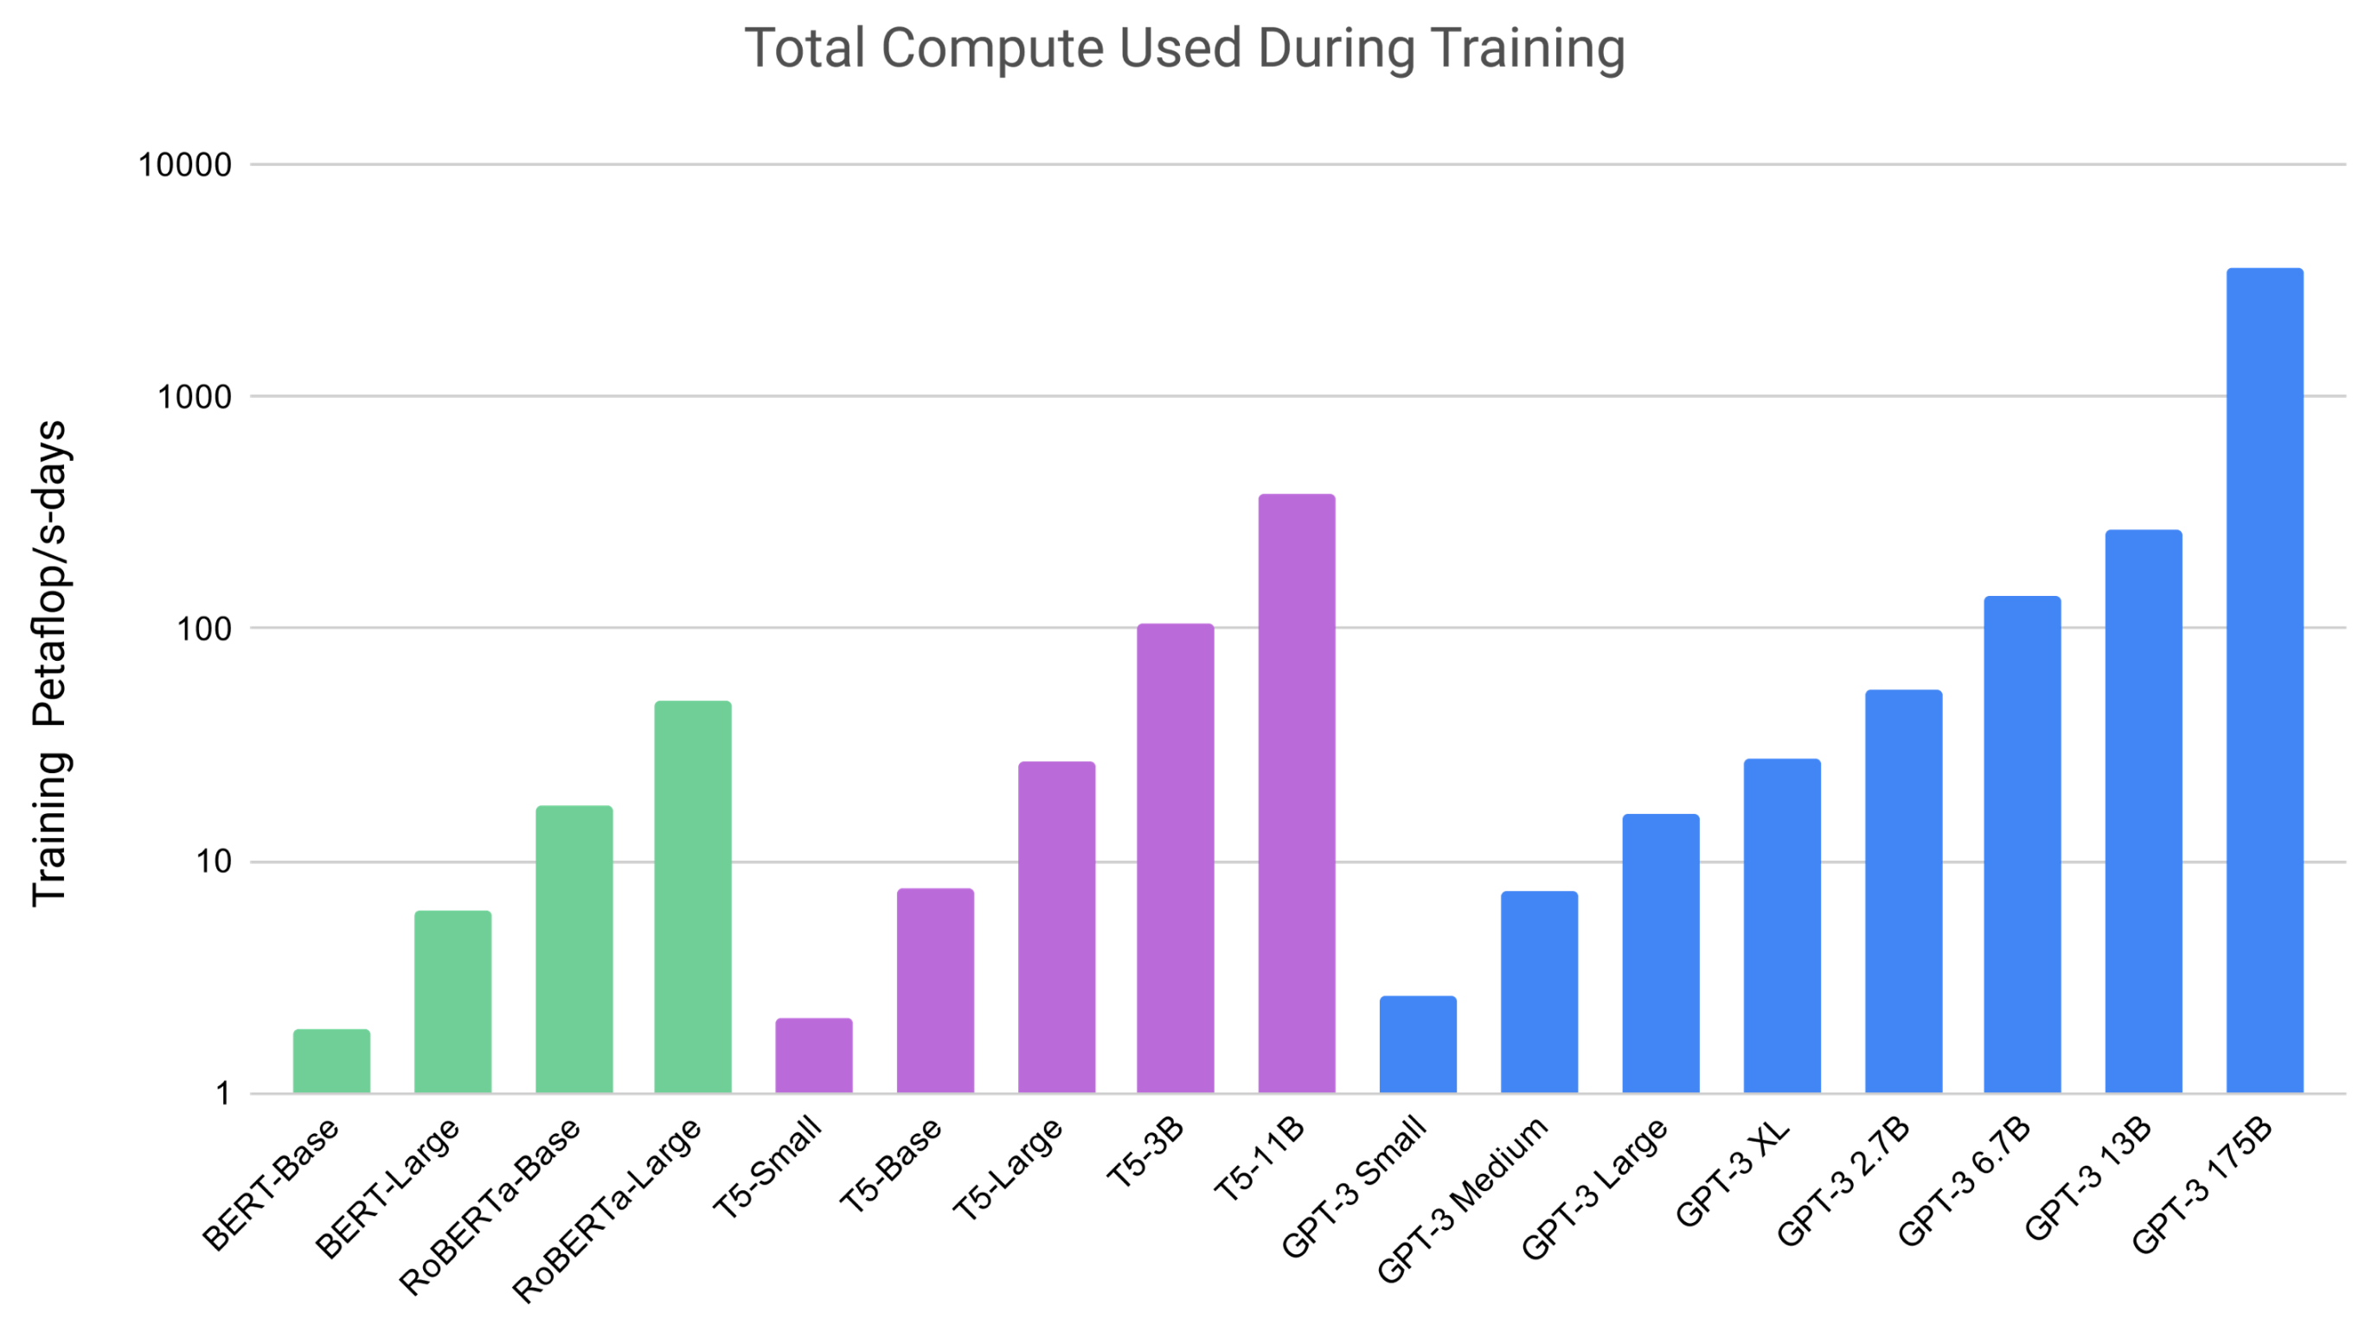
A timeline of representation learning (2/2)
2018: BERT (Bidirectional Encoder Representations from Transformers )
2019: XLNet (better than BERT)
2019-2020: large Transformer-based models for representing words (GPT-2/3, OpenAI, trained on > 1 billion words)

Slide 28
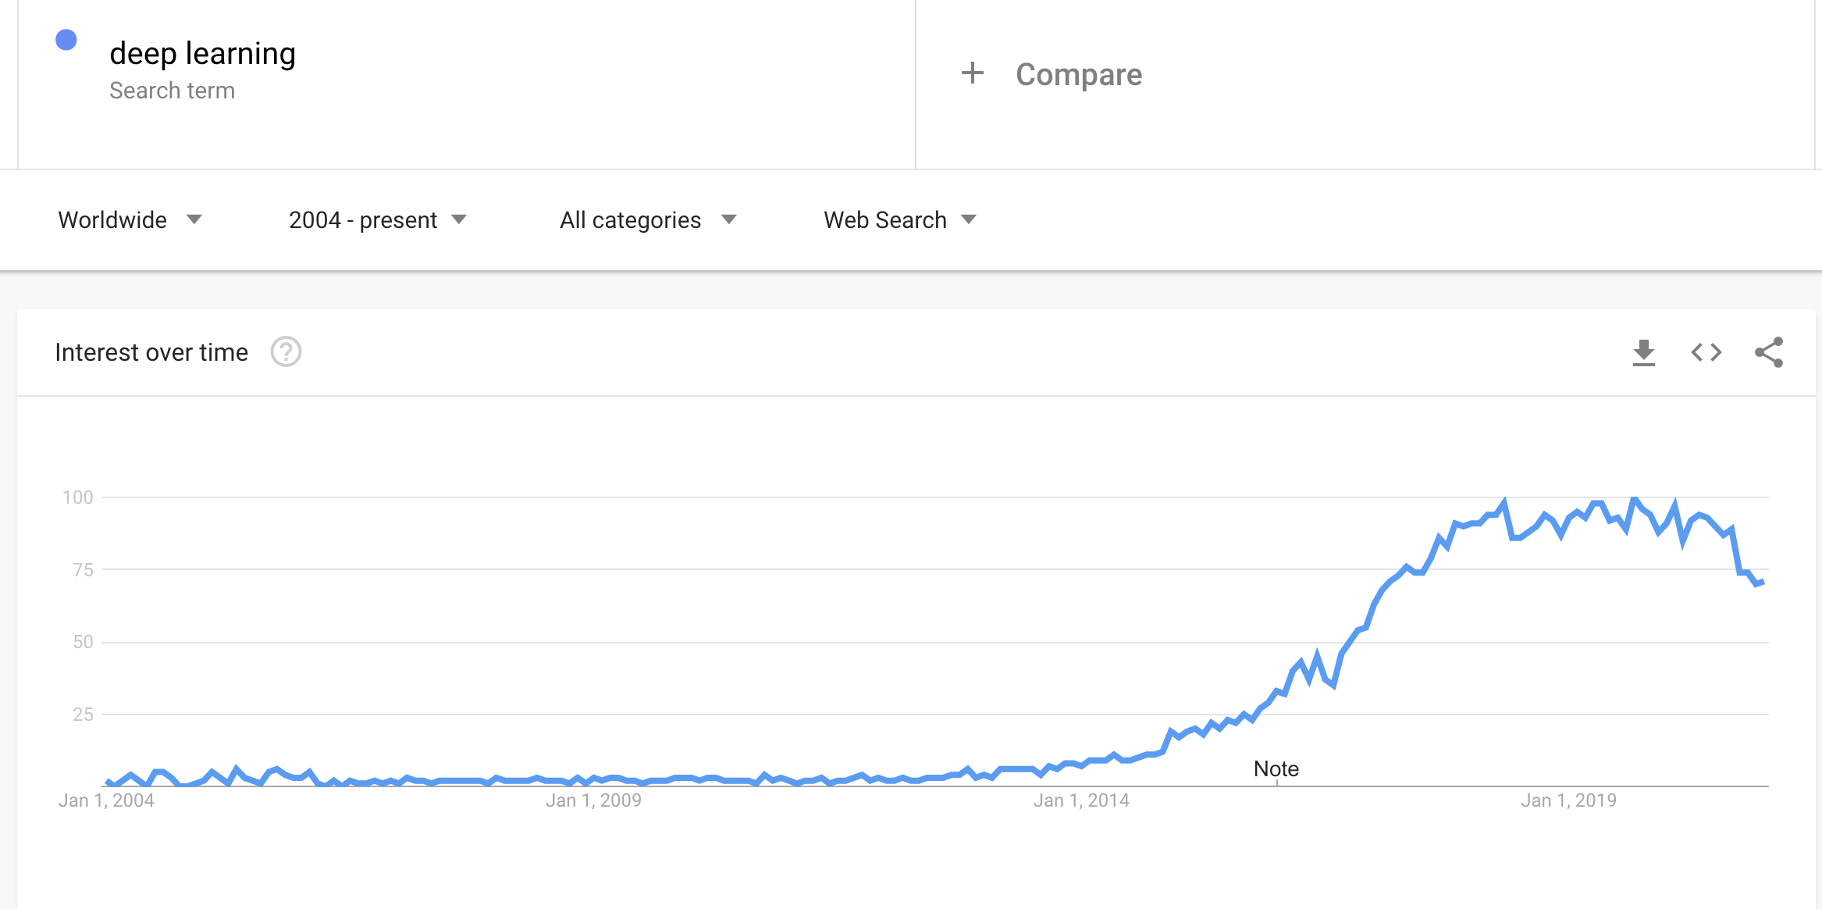
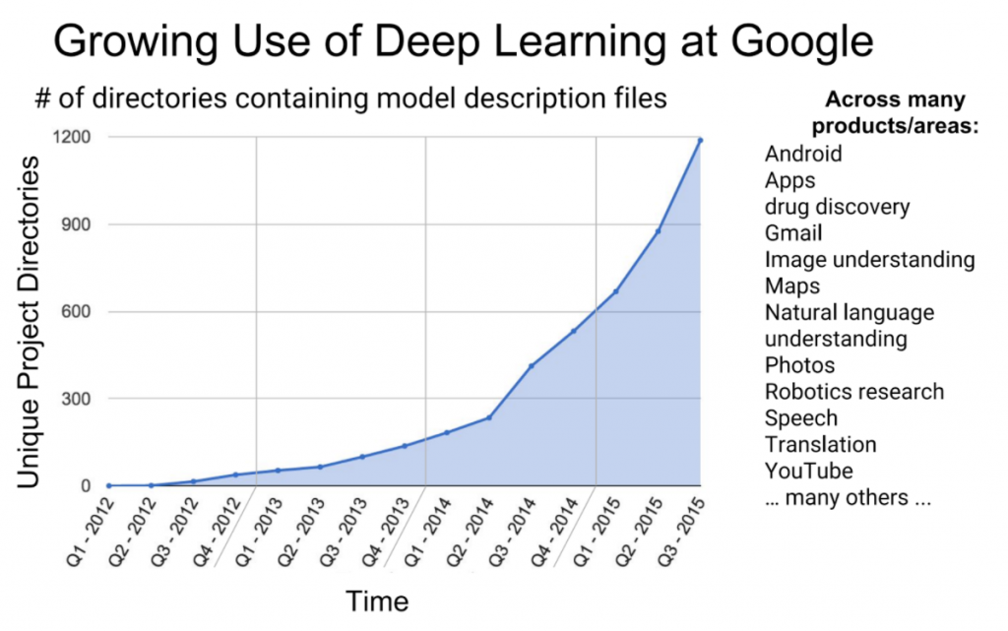
Google on Deep Learning
?
https://fabian.friedrichs.ws/research/deep-learning/ and https://trends.google.com/trends/explore?date=all&q=deep%20learning

Slide 29
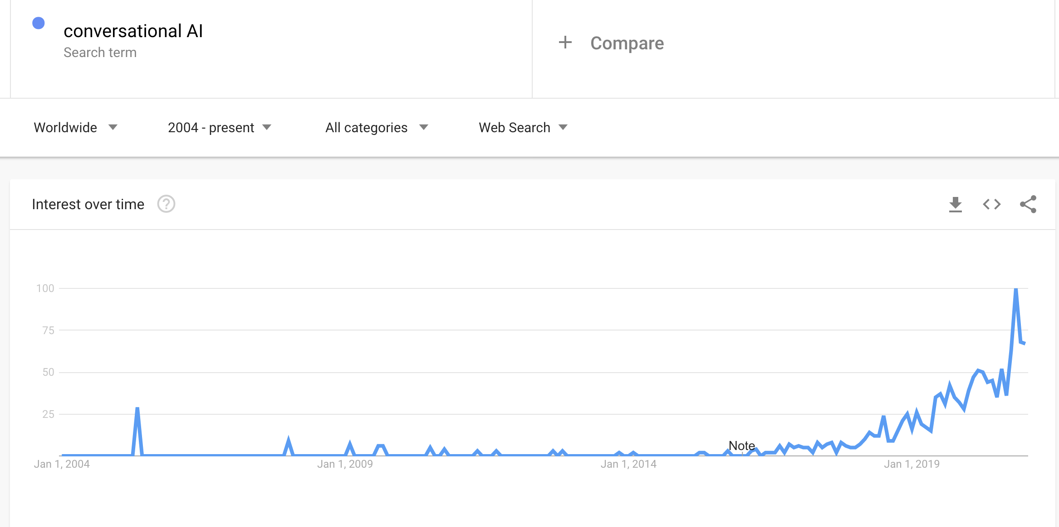
Application fields are on the rise … like CAI

Slide 30

BREAK

Slide 31
Practice: multi-class learning with sklearn
Sklearn: a general purpose machine learning library in Python (no deep learning!)
Good for practicing a bit with machine learning-based text analysis.
Environment: Google Colab
We will build a simple neural network (a perceptron) that analyzes English BBC news data, assigning topics.
label,news_item
tech,"Intel unveils laser breakthrough Intel has said it has found a way to put a silicon-based laser on a chip, raising hopes…”
sport,"Ronaldo considering new contract Manchester United winger Cristiano Ronaldo said he is close to agreeing…”

Slide 32
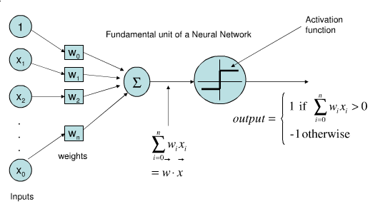
What is a Perceptron?
The “fruitfly” of neural networks

Slide 33
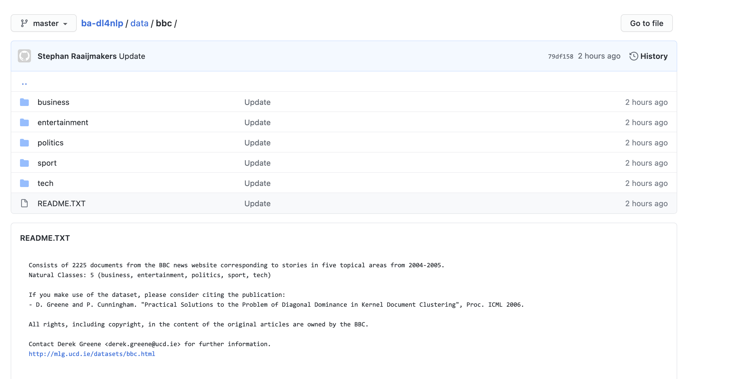
The exercise (see slides on github)
You will learn to build a text classifier for news data: a system that automatically assigns documents to classes (labels, topics).
BBC data: https://github.com/stephanraaijmakers/ba-dl4nlp/blob/master/data/bbc/bbc-all.csv
5 classes
2,225 documents (short)
Task: build a 5-class classifier and measure its performance on some test cases.

Slide 34

Hour 1: Getting started
Team up with a partner student. See table on Brightspace. Use Zoom break-out room. Rejoin to plenary session after 1 hour (includes a 15 minute break).
Create a Google account (both).
Create a Google Colab account with your Google account (both).
Create a notebook for yourself.
Share the notebook with your partner (so you can look into each other’s work)
Upload data to your notebook and start working on the exercise.
Questions (state your name, teacher connects to break-out room):

Slide 35
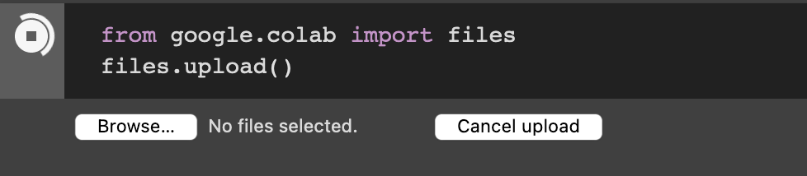
Upload data to your Colab account
Download to your computer/tablet:
https://github.com/stephanraaijmakers/ba-dl4nlp/blob/master/data/bbc/bbc-all.csv
Upload this file (see right)
Load this file into a so-called Pandas frame
A data structure that stores the data.
See next slide.

Slide 36
Reading data
import pandas as pd
df = pd.read_csv(”bbc-all.csv”)
label,news_item
tech,"Intel unveils laser breakthrough Intel has said it has found a way to put a silicon-based laser on a chip, raising hopes…”
sport,"Ronaldo considering new contract Manchester United winger Cristiano Ronaldo said he is close to agreeing…”

Slide 37
From text to input data: vector space
We can’t just input text to machine learning algorithms
We need to convert text to suitable input data
What is suitable? This differs per algorithm.
Generally speaking: we convert text into something numerical, like a vector.

Slide 38
From text to vectors
from sklearn.feature_extraction.text import TfidfVectorizer
import tfidf = TfidfVectorizer(sublinear_tf=True, min_df=5, norm='l2', encoding='latin-1', ngram_range=(1, 2), stop_words='english’)
vectors =tfidf.fit_transform(df.news_item).toarray()
labels = df.category_id
features.shape

Slide 39
Now for real…
import sys
from sklearn.model_selection import train_test_split
from sklearn.feature_extraction.text import CountVectorizer
from sklearn.feature_extraction.text import TfidfTransformer
from sklearn.linear_model import Perceptron
import pandas as pd

Slide 40
From text to vectors
df=pd.read_csv(”bbc-all.csv”,encoding= 'unicode_escape’)
X_train, X_test, y_train, y_test = train_test_split(df['news_item'], df['label'], random_state = 0)
count_vect = CountVectorizer()
X_train_counts = count_vect.fit_transform(X_train)
tfidf_transformer = TfidfTransformer()
X_train_vectors = tfidf_transformer.fit_transform(X_train_counts)

Slide 41
Let’s train a classifier: a Perceptron
clf=Perceptron().fit(X_train_tfidf, y_train)
print(clf.predict(count_vect.transform(["The game ended in a high score for the Lions"])))
=> [u'sport']

Slide 42
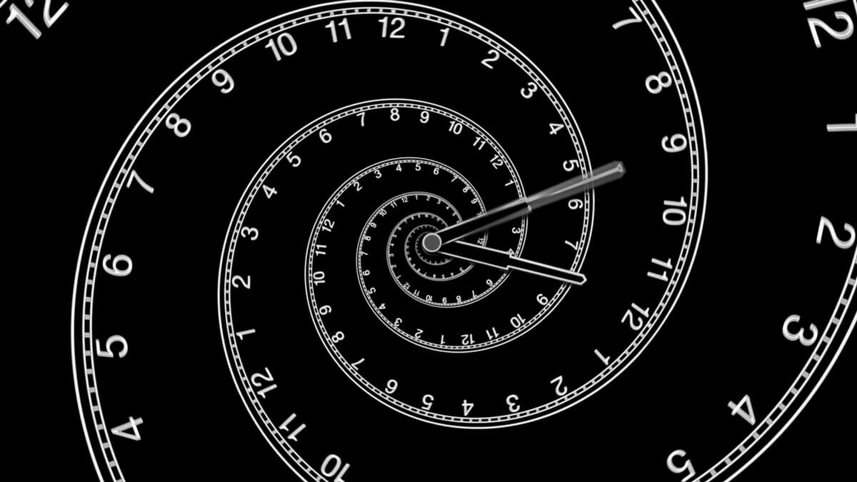
Second hour

Slide 43
Questions? (15 minutes)

Slide 44
Third hour

Slide 45
Explanation (15 minutes)

Slide 46
Vectorizing our data for the Perceptron
TF.IDF

Slide 47
What does the Perceptron do?
It learns weights for every TF.IDF score in a document.
It sums these weights, and estimates a threshold.
It learns to predict multiple classes (5). So, how does it do that?
One-vs-one versus One-vs-Rest

Slide 48
In this class you learned…
How to set up a machine learning environment in the cloud.
How to build, train and run a document classifier.
How a Perceptron works.
About vectors and vectorization data.

Slide 49

Homework
Finish exercise.
Come up with 50 text examples (in the 5 categories, so 10 each), and measure the error of the classifier, per class label. Get these examples from any English newspaper site. Select snippets comparable in size to the original data.
Document your results:
example, true class (you decide), predicted class.
Document number of errors per class
Finish the Week 1 Quiz at @@@
Read Chapter 1 of DL4NLP
Next week:
Classifier evaluation.
Machine learning ‘hygiene’.
Vectorization (turning text into vectors).

